Slide 1
Builder Pattern
Lecture 16

Slide 2
Builder Pattern
The builder pattern is a design pattern designed to provide a flexible solution to various object creation problems in object-oriented programming.
The intent of the Builder design pattern is to separate the construction of a complex object from its representation.

Slide 3
Problem
The Builder design pattern solves problems like:
How can a class (the same construction process) create different representations of a complex object?
How can a class that includes creating a complex object be simplified?

Slide 4
Solution
The Builder design pattern describes how to solve such problems:
Encapsulate creating and assembling the parts of a complex object in a separate Builder object.
A class delegates object creation to a Builder object instead of creating the objects directly.

Slide 5
Intent
The intent of the Builder design pattern is to separate the construction of a complex object from its representation. By doing so the same construction process can create different representations.

Slide 6
Advantages
Advantages of the Builder pattern include:
Allows you to vary a product's internal representation.
Encapsulates code for construction and representation.
Provides control over steps of construction process.

Slide 7
Disadvantages
Disadvantages of the Builder pattern include:
Requires creating a separate ConcreteBuilder for each different type of product.
Requires the builder classes to be mutable.
Dependency injection may be less supported.

Slide 8
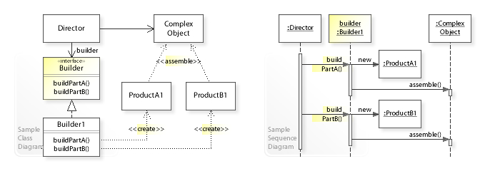

Slide 9
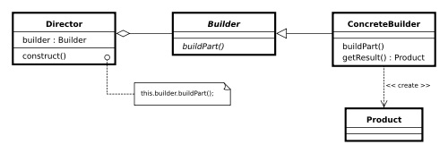
Class diagram

Slide 10
Represents a product created by the builder
public class Car
{
public string Make { get; set; }
public string Model { get; set; }
public int NumDoors { get; set; }
public string Colour { get; set; }
public Car(string make, string model, string colour, int numDoors)
{
Make = make; Model = model;
Colour = colour; NumDoors = numDoors;
}
}

Slide 11
/// The builder abstraction
public interface ICarBuilder
{
string Colour { get; set; }
int NumDoors { get; set; }
Car GetResult();
}

Slide 12
/// Concrete builder implementation
public class FerrariBuilder : ICarBuilder
{
public string Colour { get; set; }
public int NumDoors { get; set; }
public Car GetResult()
{
return NumDoors == 2 ? new Car("Ferrari", "488 Spider", Colour, NumDoors) : null;
}
}

Slide 13
/// The director
public class SportsCarBuildDirector
{
private ICarBuilder _builder;
public SportsCarBuildDirector(ICarBuilder builder)
{
_builder = builder;
}
public void Construct()
{
_builder.Colour = "Red";
_builder.NumDoors = 2;
}
}

Slide 14
public class Client
{
public void DoSomethingWithCars()
{
var builder = new FerrariBuilder();
var director = new SportsCarBuildDirector(builder);
director.Construct();
Car myRaceCar = builder.GetResult();
}
}

Slide 15
References
https://en.wikipedia.org/wiki/Builder_pattern

